Slide 1
INITATION OF dialysis : Early versus late
Prof.Dr. Ali Taha Alkoriaty
Professor of internal medicine and nephrology
Head of nephrology unit
Suhag faculty of medicine

Slide 2
Agenda
Introduction
Goals of dialysis
Indications of dialysis
Parameters for assessment of renal function
Early versus late
Nephrological Referral
When and how to tell the patient about dialysis
conclusion

Slide 3
introduction
If you asked 100 nephrologists, when is the right moment to start renal replacement therapy in a patient, you probably would get 100 different answers
when to start dialysis is clearly one of the most difficult decisions that both the patient and the nephrologist must make.
The decision to initiate dialysis in a patient with ESRD involves the consideration of subjective and objective parameters by the physician and the patients.

Slide 4
introduction
The decision to start maintenance dialysis should not be only based upon serum creatinine or estimated GFR.
The decision to start dialysis has a negative psychological impact on patients . With Important socio-economic implication

Slide 5
Goals of dialysis.
Free of uremic symptoms.
Control volume overload.
Control of acid - base and electrolyte disorders.
Provide clearance of uremic toxins enough to allow an adequate dietary protein and caloric intake.
When residual kidney functions fail to maintain all these vital functions, we have to start dialysis therapy.
Since an important goal of dialysis is to enhance quality of life as well as to prolong survival.

Slide 6
INDICATIONS of dialysis
Compiling indications :
Pericarditis or pleuritis (urgent indication)
Progressive uremic encephalopathy or neuropathy, with confusion, asterixis, myoclonus, wrist or foot drop, or seizures (urgent indication)
significant bleeding diathesis attributable to uremia (urgent indication)
Persistent metabolic disturbances that are refractory to medical therapy:hyperkalemia, metabolic acidosis, hypercalcemia, hypocalcemia, and hyperphosphatemia

Slide 7
INDICATIONS of dialysis (cont.)
Compiling indications (cont.)
Fluid overload refractory to diuretics
Persistent uremic manifestations as nausea and vomiting or evidence of malnutrition
If it was that simple a no need for this lecture!
As RRT should be started before these life threatening complications appear

Slide 8
INDICATIONS of dialysis(cont.)
Relative indications
less acute indications for dialysis such as anorexia and nausea; impaired nutritional status; increased sleepiness; and decreased energy level, attentiveness, and cognitive tasking.
These relative indications illustrate the need to identify more objective markers of renal failure

Slide 9
Objective markers for Assessment of renal function
Serum creatinine.
Blood urea.
creatinine clearance.
calculated creatinine clearance or eGFR.
Others: Isotopic measures, Cystatin C.

Slide 10
STARTING dialysis: Early versus Late
The key question is whether we have to start dialysis prior to, or after the overt development of these uremic symptoms and signs.
When to start dialysis is a subject to be controversy.

Slide 11
STARTING dialysis: Early versus Late
Since 2001, 10 observational studies have examined the issue of comorbidity-adjusted survival versus eGFR level (as assessed MDRD equation) at dialysis initiation.
All but two of these studies found a comorbidity-adjusted survival disadvantage of early dialysis initiation.
Korevaar JC, et al., Lancet, 2001

Slide 12
STARTING dialysis: Early versus Late The dilemma
Malnourished fragile patients with low muscle mass with or without obvious comorbidities and with potential low survival may start dialysis with a high eGFR due to low creatinine appearance.
On the other hand, ‘healthy’ well-nourished patients with high muscle mass will have a higher serum creatinine and lower eGFR but a relatively low mortality risk.
Ramkumar et al., Perit Dial Int 2005

Slide 13
Benefits of early initiation:
easier management of comorbid conditions,
better nutritional status,
better blood pressure
Better metabolic control, and
lesser need for hospitalization
Hence; better outcome and, lower economic burden.
Wright et al., Clin J Am Soc Nephrol 2010

Slide 14
Bad effects of early HD
Cardiovascular Comorbidity and Early Dialysis
Incident and prevalent hemodialysis patients have high prevalence of
left ventricular hypertrophy,
systolic and diastolic dysfunction, and
ischemic myocardial disease and are prone to
sudden cardiac death
myocardial stunning, and
ventricular arrhythmias.
McIntyre CW. Kidney Int, 2009
Sniderman AD, et al., Clin J Am Soc Nephrol, 2010
Pun et al., Kidney Int, 2009

Slide 15
Bad effects of early HD
Complications directly related to the dialysis therapy:
Infectious complication, however, seems to be an important source of morbidity and mortality.
Septicemia rates related to vascular access are rising, especially in the older population, where central catheters are used increasingly.
Shemin D, et al.,. Am J Kid Dis, 2001

Slide 16
Bad effects of early HD
Other potential sources of morbidity and mortality are hypotensive episodes during hemodialysis.
It could be argued that rapid deterioration of residual renal function may be responsible for the observed excess mortality in the patients starting dialysis early.
Termorshuizen et al.,(NECOSAD)-2. Am J Kidney Dis 2003

Slide 17
Benefits of early start of dialysis
But survival benefit is unproven.
Key evidence relating overall outcome or mortality to the timing of dialysis initiation is lacking. Ronco C, et al: Peritoneal Dialysis Today. Contrib Nephrol. Basel, Karger, 2003, vol 140, pp 176–186
Also the potential complications of dialysis, and the changes in the way of life that many patients have to endure, are factors which should temper this decision.

Slide 18
start dialysis is a subject to be controversy
NKF (1997):
Start dialysis with eGFR ~10.5 … on the basis of the minimum target level of total clearance (residual renal and dialysis) for peritoneal dialysis.
KDOQI (2006):
RRT should be considered at
• eGFR < 15
OR
• eGFR > 15
when patients have ‘co‐morbidities’ or symptoms of uremia.

Slide 19
start dialysis is a subject to be controversy
Canadian guidelines:
Recommend Start dialysis with eGFR < 6 ml/min/1.73m
Europian Best Practice Guidelines
RRT should be considered at
• eGFR < 8 ml/min/1.73m
OR
• eGFR > 10- 20 ml/min/1.73m
If
Coexisting malnutrition
Fluid overload
Therapy resistsant hypertention

Slide 20
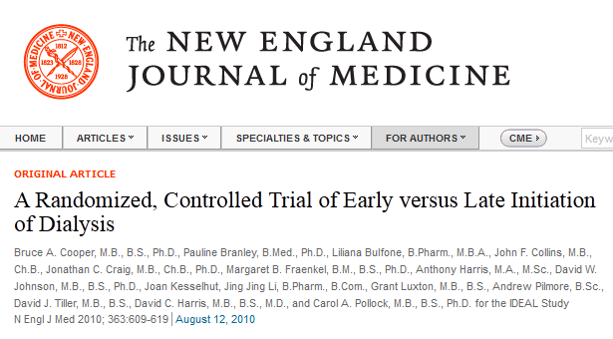
The Initiating Dialysis Early and Late (IDEAL) This study was conducted at 32 centers in Australia and New Zealand and designed to determine whether initiating dialysis early in people with stage 5 CKD reduces the rate of death from any cause or is associated with a reduction in cardiovascular and infectious events and in complications of dialysis.

Slide 21

Methods:
Patients 18 years of age or older (828 pts) with progressive CKD were randomized and planned for initiation of dialysis when the eGFR was 10.0 to 14.0 ml/min (early start “ 404 pts ”) or when the estimated GFR was 5.0 to 7.0 ml/min (late start “ 428 pts”). The primary outcome was death from any cause.
Results:
There was no significant difference between the groups in the frequency of adverse events (cardiovascular events, infections, or complications of dialysis).

Slide 22
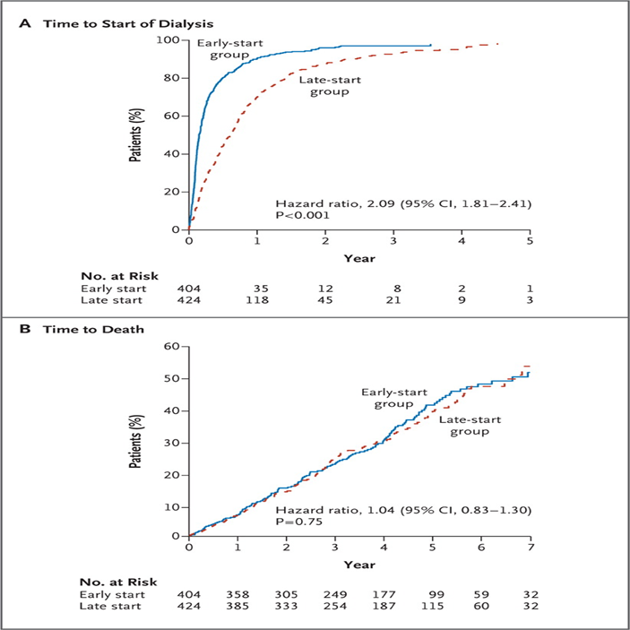
IDEAL syudy

Slide 23
IDEAL syudy
Conclusions:
Planned early initiation of dialysis in patients with stage 5 CKD was not associated with an improvement in survival or clinical outcomes.
The results show that with careful clinical management, dialysis may be delayed until either the GFR drops below 7 ml per minute or more traditional clinical indicators for the initiation of dialysis are present.
Dialysis should not start on eGFR alone.

Slide 24
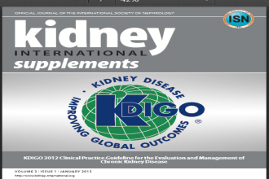
KDIGO: Initiation of dialysis
5.3: TIMING THE INITIATION OF RRT:
5.3.1: Dialysis is to be initiated when one or more of the following are present:
Symptoms or signs attributable to kidney failure:
(serositis, acid-base or electrolyte abnormalities, Pruritus).
Inability to control volume status or blood pressure.
A progressive deterioration in nutritional status refractory to dietary intervention.
Cognitive impairment.
This often but not invariably occurs in the GFR range between 5 and 10 ml/min. (2B)

Slide 26
The question is :
which is more harmful
‘late start’
or
‘late referral’

Slide 27
Referral to nephrologist
Early nephrological referral and predialysis care are essentials to prolong patient`s survival.
Studies suggest increased all-cause mortality in patients referred late
Patients who require dialysis within 3 months of referral to a nephrologists are at increased risk of morbidity and mortality than those under long-term specialist care.
Up to 40% of patients begin RRT <6months after referral to a nephrologist.

Slide 28
Referral by GFR
Early referral :at e GFR 60ml/min.
Late referral = less than 10 ml/min.

Slide 29
Why early referral ?
Better ability to slow rate of progression of renal deterioration.
Reversible causes (vasculitis, etc).
Management of comorbidities (Anemia, bone-mineral
metabolism, hypertension, malnutrition).
Early dietary interventions including healthy life style advice to minimize cardiovascular morbidity
Discussion of dialysis modalities and transplantation.
Early creation of dialysis access.
hepatitis B vaccination can be carried out predialysis when the immune response is greater.
Decrease need for urgent dialysis.

Slide 30

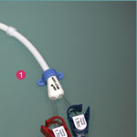
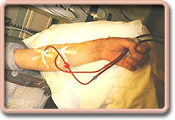
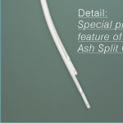
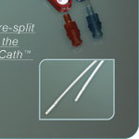
What are the benefits of earlier referral?
or

Slide 31
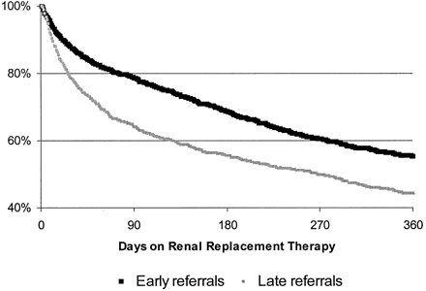
Early Vs late referral
A Kaplan-Meier plot of patient survival confirmed that patients who actually were referred late had a lower survival in the first year of maintenance dialysis compared with those who were referred to a nephrologist earlier .
Similarly, the corresponding Cox proportional hazards model revealed a 40% higher mortality rate during the first year among LR compared with ER. Wolfgang JASN February 1, 2003 vol. 14 no. 2 486-492
1564 patients completed the 1-yr follow-up

Slide 32
Why patient is referred late?
Ignorance of the value of early referral (Nephrologist= dialyser)
Physician attitude.
Under-estimation of severity of renal failure.
Presence of other co morbidities.
Lack of communications.
Patient refusal.
Economic factors.

Slide 33
How to avoid late referral?
Education
Progression rates vary
Creatinine is a flawed marker
Management of CRF is a dynamic process
Age is not a criterion
Assess high risk patients before they have symptomatic uraemia
Integrated follow-up
Primary care
General physician
Geriatrician
Nephrologist
Urologist

Slide 34
When to tell your patient about dialysis?
The algorithm of “30–20–10 rule,” based upon estimated GFR to determine the time for access planning as follows:
GFR 30 – Initiate education of the patient and family relating to ESRD management including the options of transplantation, dialysis alternatives, and dialysis access
GFR 20 – Initiate access placement (arteriovenous, peritoneal) and initiate work-up for the transplant list
GFR 10 – Initiate dialysis
Oliver MJ et al ,J Am Soc Nephrol. 2004;15(7):1936

Slide 35
How to tell your patient about dialysis??.
Try to be as logic as possible.
Tell him the truth… may be not all the truth!!
You should know how to deal with Patient response to starting dialysis

Slide 36
Conclusions
It can be reasonably stated that time of initiation of dialysis treatment cannot be based on numerical data, but should be decided according to the overall clinical evaluation of each individual patient not only based upon serum creatinine or estimated GFR.
Decision when to start dialysis should be individualized to each patient
early dialysis initiation does not consistently provide a mortality, morbidity, or quality of life benefit, unless accompanied by compelling reasons for initiating treatment.

Slide 37
Conclusions
Early dialysis initiation using only creatinine-based eGFR for decision making may be harmful.
Late referral the enemy, not the eGFR alone or the late start of dialysis
Future studies examining indications for dialysis initiation and outcomes will contribute to evidence-based guidelines concerning the optimal timing for dialysis initiation.

Slide 38


